Slide 1
AirBnb Price Prediction
Alphonsus Koong, Josh Wahl, Arda Kurama, Joseph Bertram
04/21/2026
Notes:
Bertram

Slide 2
Introduction
Short-term rental pricing is complex and location-dependent
Listings vary by:
location
room type
availability
Goal: understand factors that influence pricing
Notes:
Bertram

Slide 3
Problem Definition
Task: Predict Airbnb listing price
Type: Regression
Target variable: price (continuous)
Input: listing features (location, reviews, policies, etc.)
Notes:
Bertram

Slide 4
Related Work
Airbnb pricing widely studied using regression
Approaches used by NYC Airbnb price prediction(Wei 2025)
Linear regression
Decision Tree
Random forest
Extreme Gradient boosting
Found data is highly right skewed
Room type heavily influenced price
Tree Models outperformed linear models
Notes:
Josh

Slide 5

Dataset
Dataset: U.S. Airbnb Open Data
~200,000 listings
Each row = one listing
Static dataset (2023)
Notes:
Josh

Slide 6
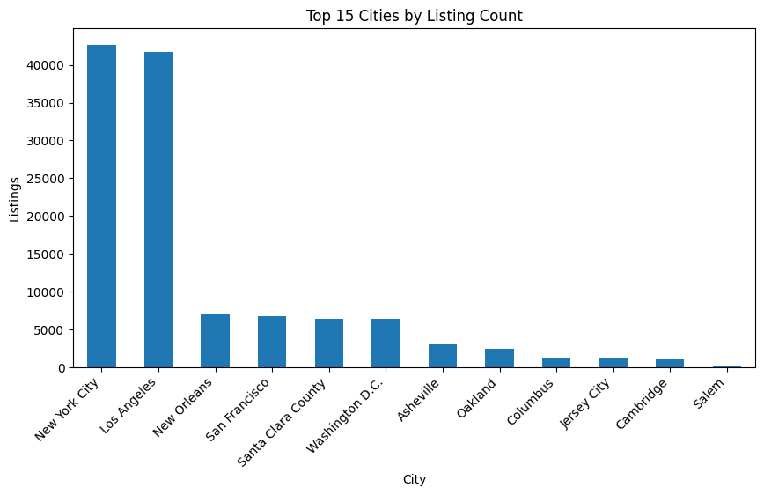
Features
Location: latitude, longitude, neighborhood
Property: room_type, minimum_nights
Reviews: number_of_reviews, reviews_per_month
Host: listings_count
Notes:
Josh

Slide 7
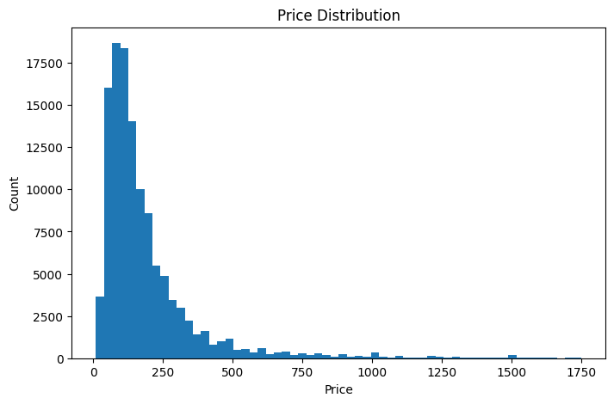
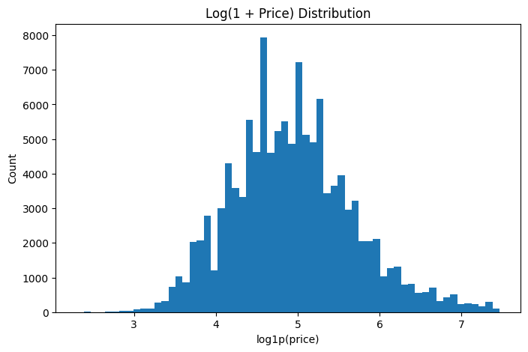
Main Target
Price (continuous numeric variable)
Right-skewed distribution
Few high-price outliers
Notes:
Arda

Slide 8
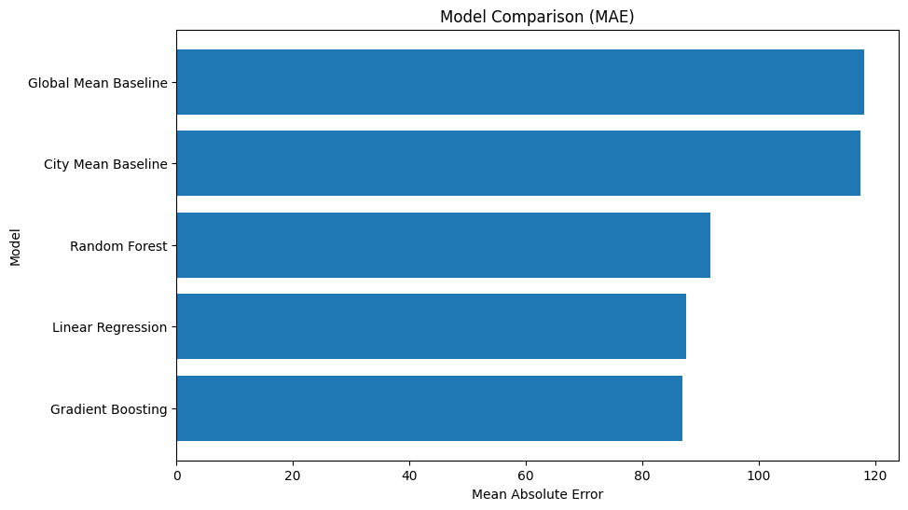
Modeling
Linear Regression
Simple and Interpretable
Assumes Linear Relationship
Random Forest
Captures nonlinearity
Robust to outliers
Gradient Boosting
Build models sequentially
Handles complex feature interactions
Notes:
Arda

Slide 9
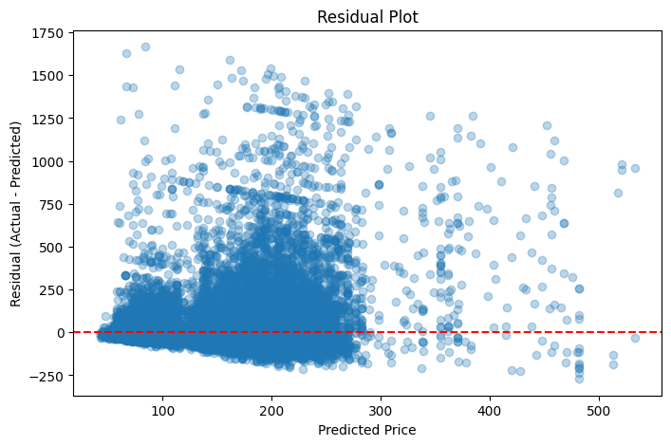
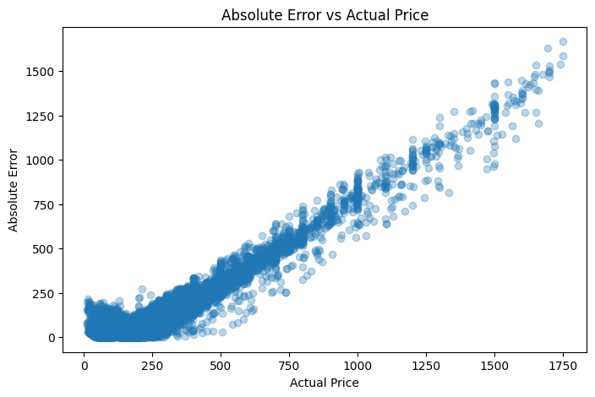
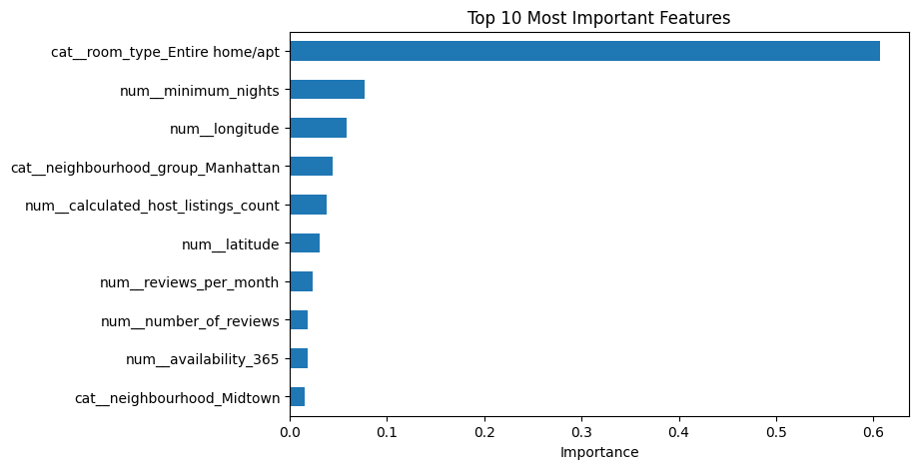
Evaluation
Strong asymmetry
When the model is wrong, it’s usually because it predicted too low
It underestimates much more than it overestimates
Error grows with price
Notes:
Arda

Slide 10
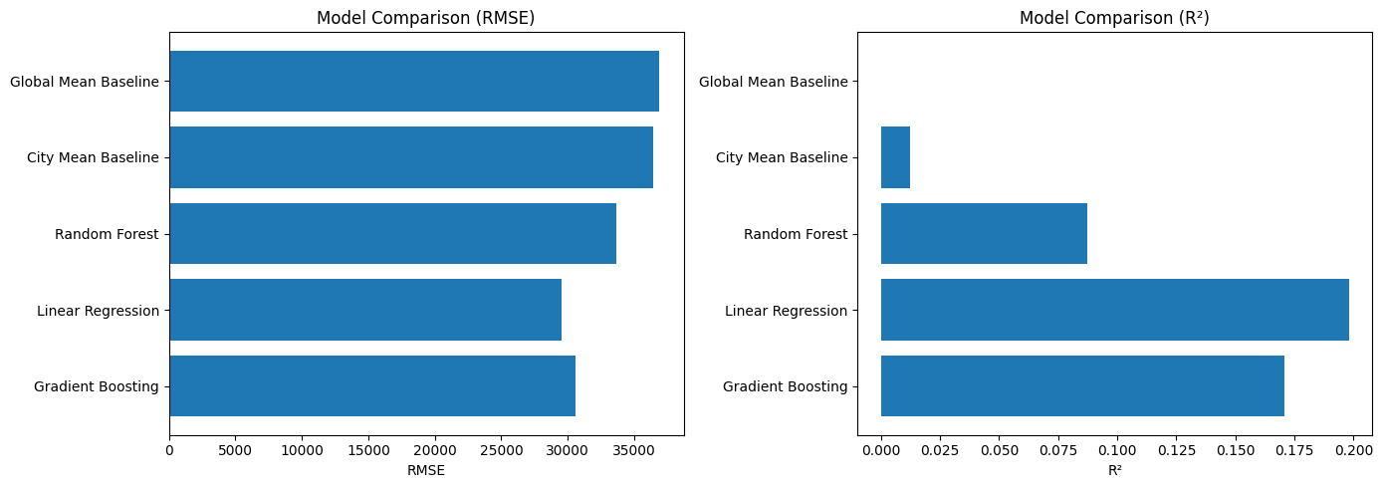
Evaluation
Baseline
Preliminary results
Notes:
Alphonsus

Slide 11
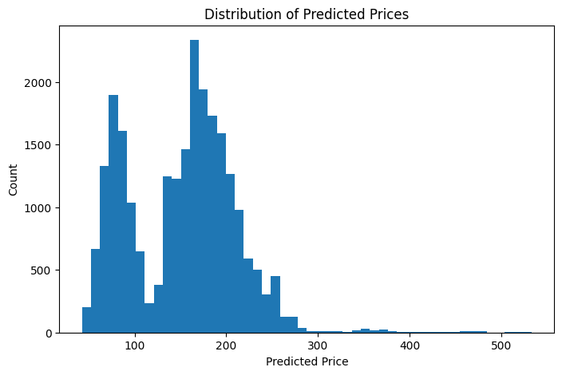
Discussion
Location and room type are the dominant drivers of price
Model performs well on typical listings but consistently underestimates high priced listings
Useful for baseline pricing but limited on outliers due to skewed data and compressed predictions
Notes:
Alphonsus

